Slide 1
Deep-Learned Compression for RF Modulation Classification
Yagna Kaasaragadda

Slide 2
Presentation Outline
Introduction
Related Work
Background
Methodologies
Experimental Results & Discussions
Conclusions, Reflection, and Outlook
Reference

Slide 3
Introduction
What ?
How efficiently can we compress an RF signal and learn the representation of those compressed signals in order to classify the signals efficiently. Even generate new signals.
Focus on the classification of the signals.
Why?
Almost every sensor or any IOT device generates RF signals and they are processed on the cloud, or stored on a remote server.
Send more data bits with the same bandwidth with efficient compression and reconstruction.
Classify the signals efficiently at the receiver’s end with less information.
How?
Using Hierarchical Quantized Auto Encoders (HQARF) for RF signals.

Slide 4
Related Work
Relevant work
Hierarchical Quantized Autoencoders (HQA):
Van den Oord, A., Vinyals, O., & Kavukcuoglu, K. (2017). Neural Discrete Representation Learning. Advances in Neural Information Processing Systems, 30, 6306-6315.
Kondo, K., Tanaka, K., & Hirai, H. (2020). Hierarchical Generative Modeling for Audio Synthesis. arXiv preprint arXiv:2012.11861.
Razavi, A., Oord, A. V. D., & Vinyals, O. (2019). Vector Quantized Variational Autoencoders. arXiv preprint arXiv:1905.10548.
RF Signal Compression using Machine Learning:
O'Shea, T., & Hoydis, J. (2017). Deep Learning for Wireless Communications. IEEE Transactions on Signal Processing, 65(11), 3551-3564.
Ye, J., Zhang, Z., & Xu, K. (2018). Deep Learning Based Signal Processing in Wireless Communications. IEEE Wireless Communications, 25(5), 59-65.
O'Shea, T., & Hoydis, J. (2017). End-to-End Deep Learning for Physical Layer Communications. IEEE Journal on Selected Areas in Communications, 35(10), 2403-2417.

Slide 5
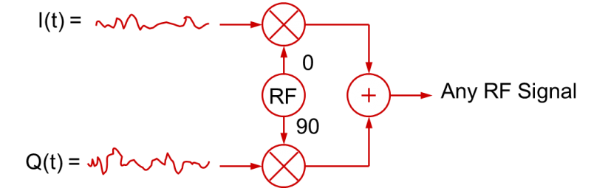
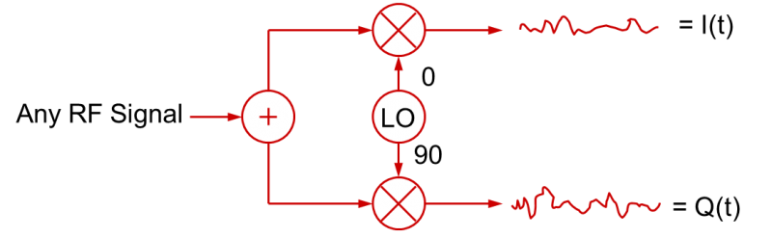
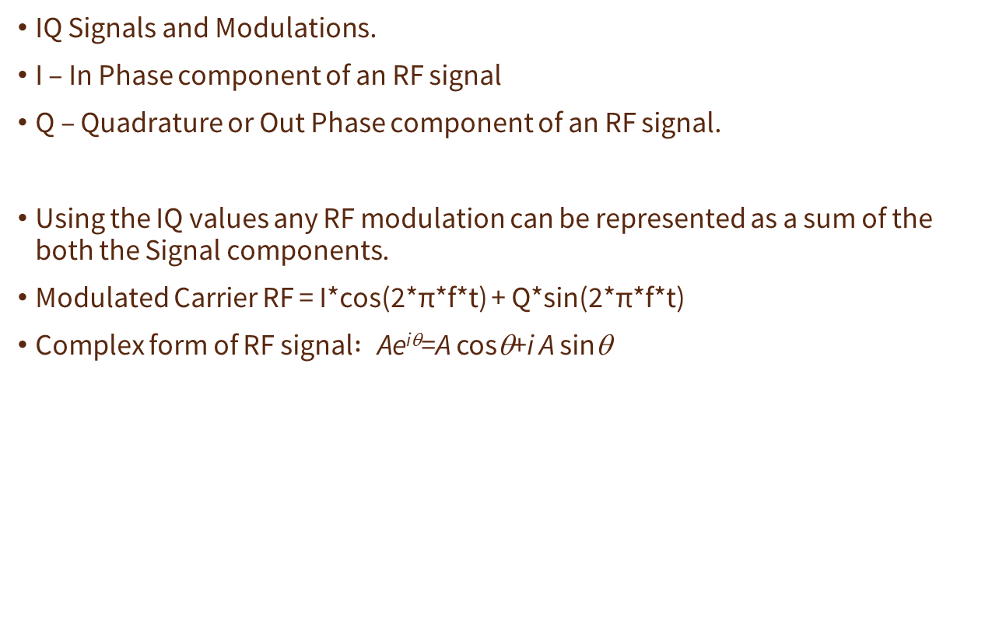
Background
IQ Signals and Modulations.
I – In Phase component of an RF signal
Q – Quadrature or Out Phase component of an RF signal.
Using the IQ values any RF modulation can be represented as a sum of the both the Signal components.
Modulated Carrier RF = I*cos(2*π*f*t) + Q*sin(2*π*f*t)
Complex form of RF signal$: \text{Ae}\text{i}\text{θ}\text{=}\text{A} \text{cos}\text{θ}\text{+}\text{i} \text{A} \text{sin}\text{θ}$
From https://en.wikipedia.org/wiki/In-phase_and_quadrature_components
Radio Channel
From https://www.tek.com/en/blog/quadrature-iq-signals-explained

Slide 6
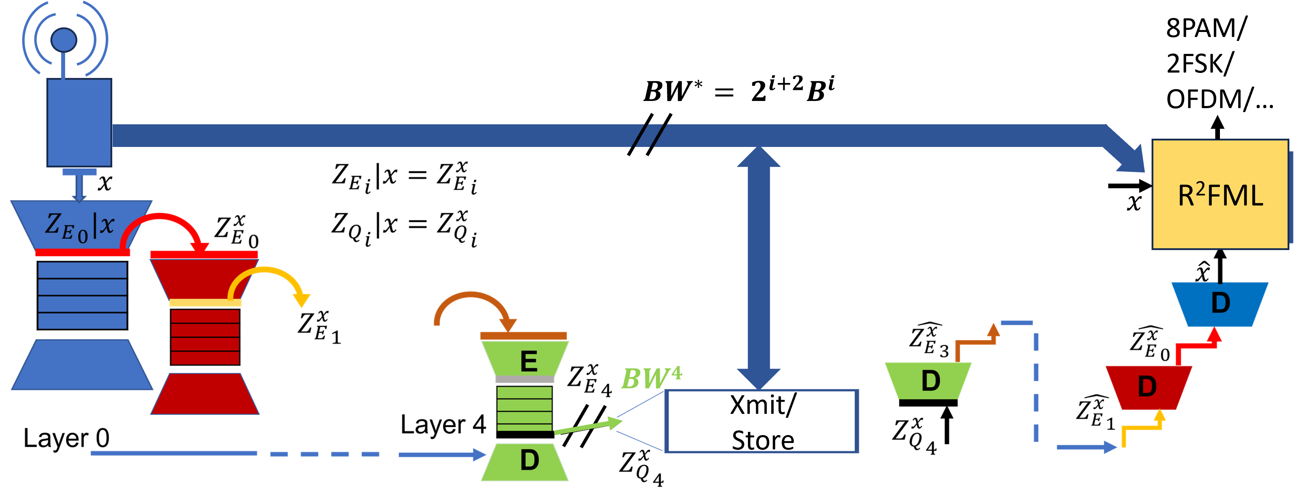
Background (Continued..)
Encoder:
Compresses the data into a latent space Z_{e}.
Generally a series of convolution blocks
Decoder:
Takes the Z_{e} as input and upscales it into the original input data.
Generally a series of DeConv or Transpose Convolution layers.
Auto Encoders
Resnet blocks
F(x) = x+ Conv(x)
Hierarchical Quantized Auto Encoders
Encoder
Z_{e}
Decoder

Slide 7
Background (Continued..)
Vector Quantization
Learn a set of vectors representing the entire input dataset or entire feature set of input dataset.
Z_{q} is the quantized vector.
Z_{e} is the input vector.
Each the point in the codebook is called a codeword. Each codeword is a learnable parameter.
Pick the Z_{q} from the codebook that is closest to the Z_{e}.
Quantization error is usually the distance between the input vector and the quantized vector.
The distance metric is generally Euclidian distance.
Z_{q}
Z_{e}

Slide 8
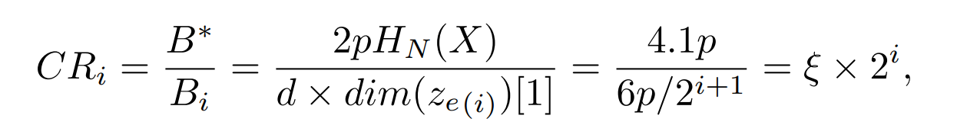
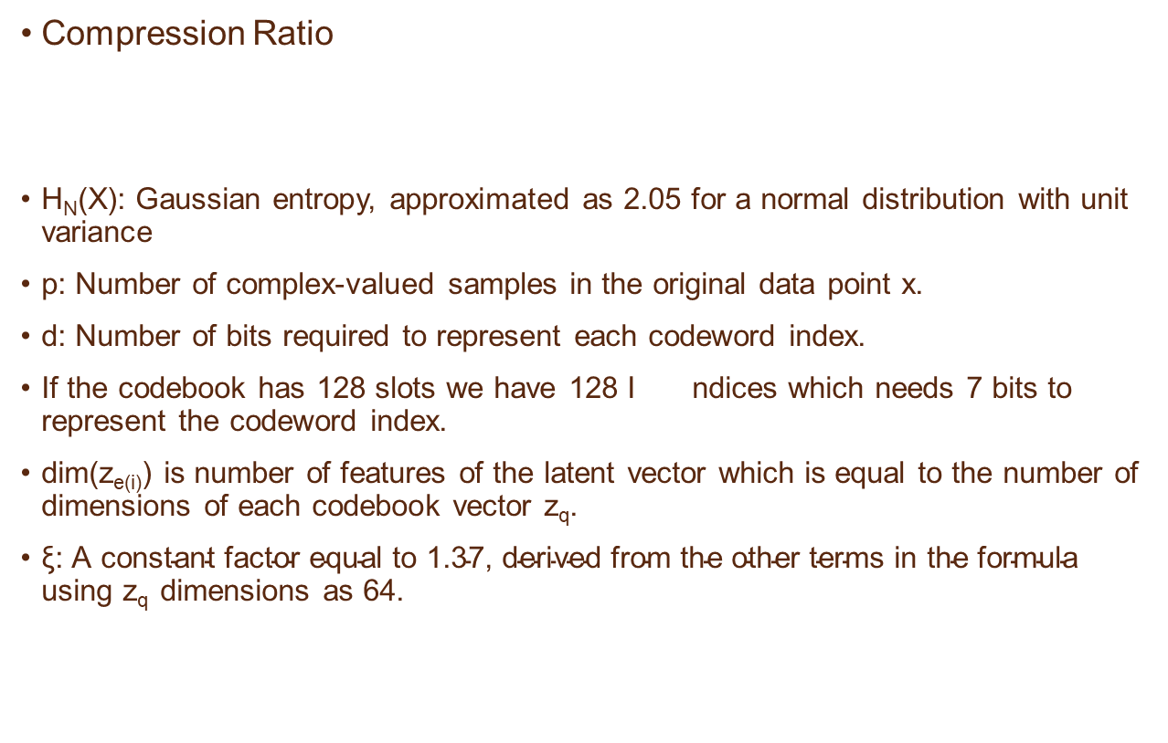
Background (Continued..)
Compression Ratio
H_{N}(X): Gaussian entropy, approximated as 2.05 for a normal distribution with unit variance
p: Number of complex-valued samples in the original data point x.
d: Number of bits required to represent each codeword index.
If the codebook has 128 slots we have 128 I ndices which needs 7 bits to represent the codeword index.
dim(z_{e(i)}) is number of features of the latent vector which is equal to the number of dimensions of each codebook vector z_{q}.
$\text{ξ}\text{: }\text{A} \text{constant} \text{factor} \text{equal} \text{to}\text{ 1.37, }\text{derived} \text{from} \text{the} \text{other} \text{terms} \text{in} \text{the} \text{formula}$ using z_{q} dimensions as 64.

Slide 9
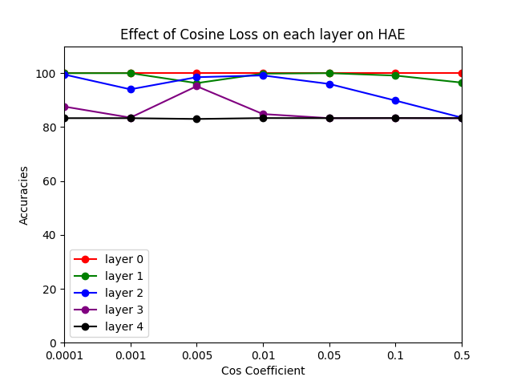
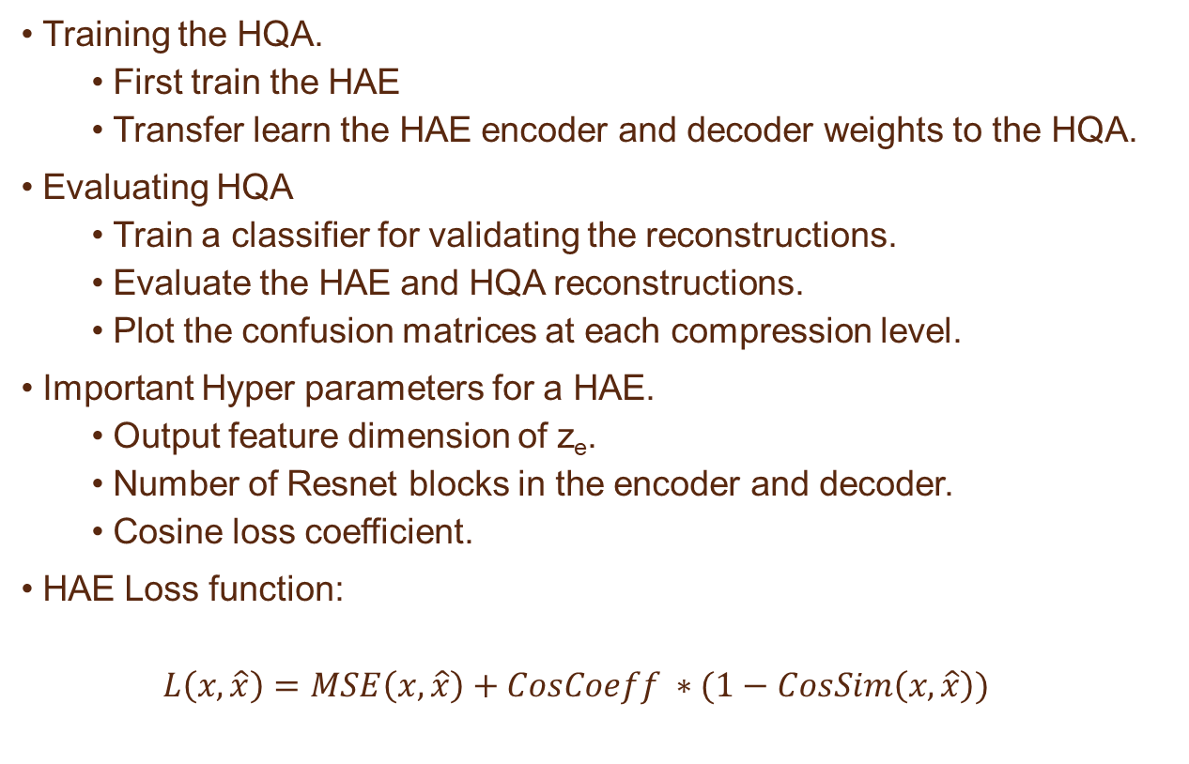
Methodologies
Training the HQA.
First train the HAE
Transfer learn the HAE encoder and decoder weights to the HQA.
Evaluating HQA
Train a classifier for validating the reconstructions.
Evaluate the HAE and HQA reconstructions.
Plot the confusion matrices at each compression level.
Important Hyper parameters for a HAE.
Output feature dimension of z_{e}.
Number of Resnet blocks in the encoder and decoder.
Cosine loss coefficient.
HAE Loss function:
$$L\left(x, \hat{x}\right)=MSE\left(x,\hat{x}\right)+CosCoeff ∗(1−CosSim\left(x,\hat{x}\right))$$

Slide 10

Methodologies (Continued..)
Get the best HAE possible.
Now freeze the HAE’s Encoder and Decoder part and just try to learn the codebook of the HQA.
HQA loss function:
KL Loss is the probability loss function to optimize or move the input latent vector z_{e} towards the codeword z_{q}.
CL Loss is the commit loss which moves the quantized vector towards the input latent vector.
In this project my focus was more on optimizing the codebook rather than optimizing the whole model.

Slide 11
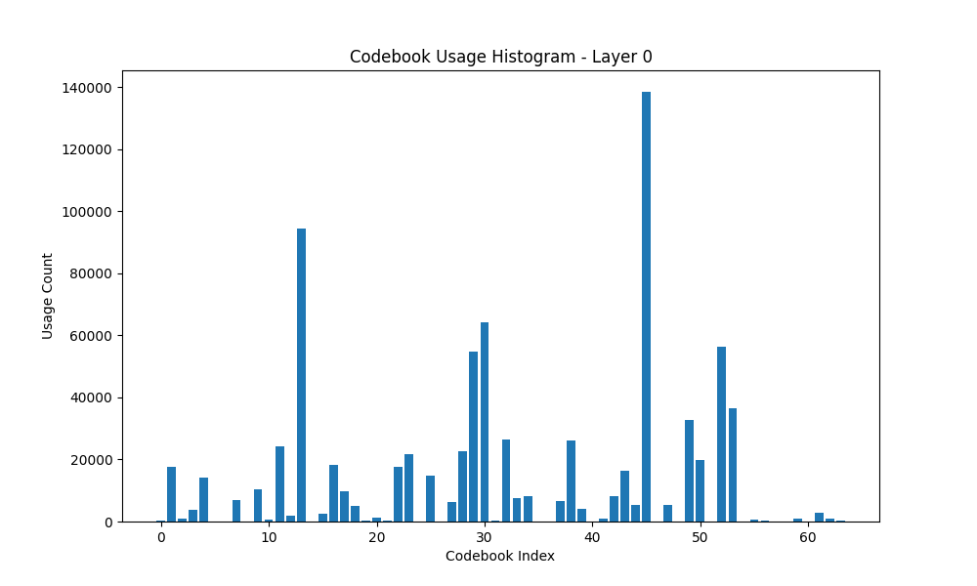
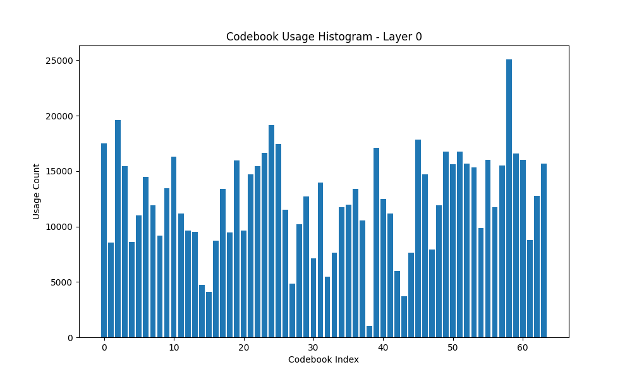
Methodologies (Continued..)
Issues for Codebook optimization
Codebook Saturation
Same Indices might be used multiple times for different input data.
Can’t explore the entire codebook dimensions.
Reset the least used codeword at a frequent interval during training (which can be a hyper parameter).

Slide 12
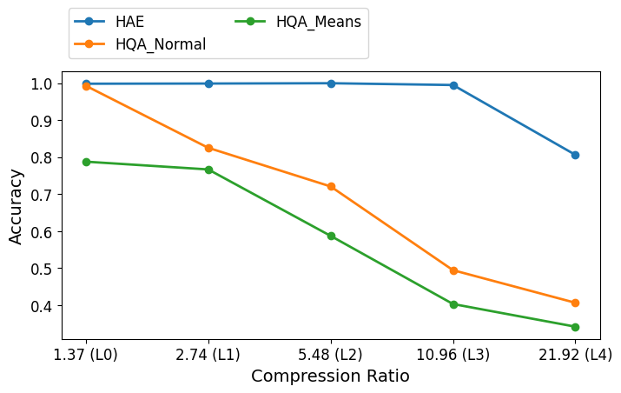
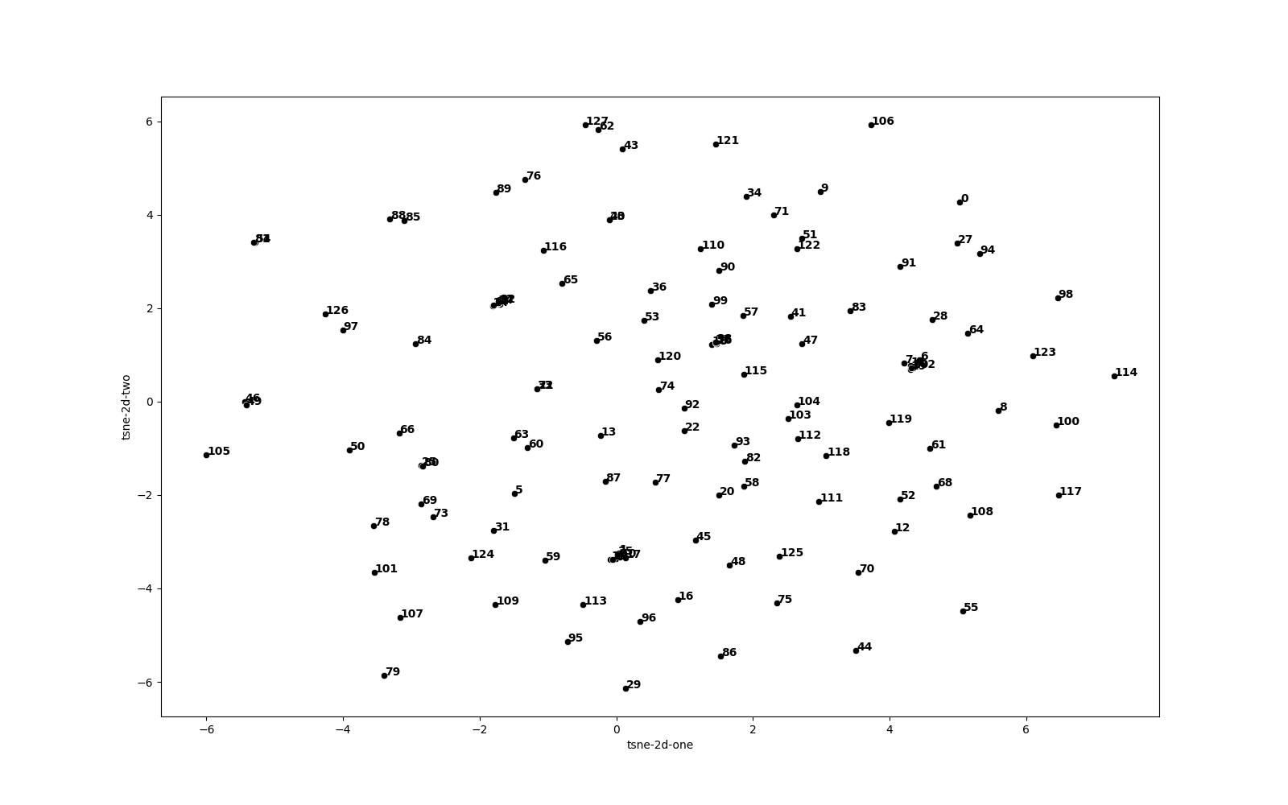
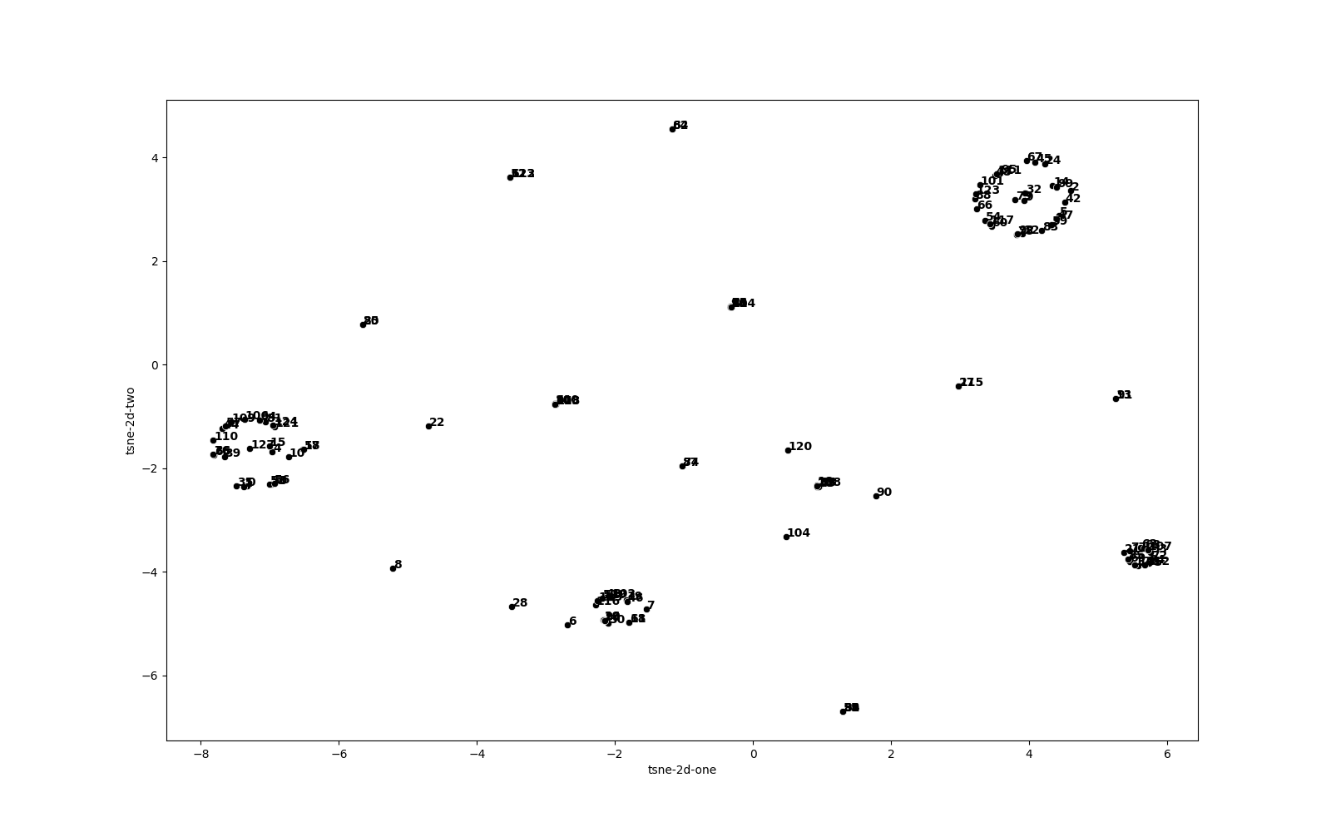
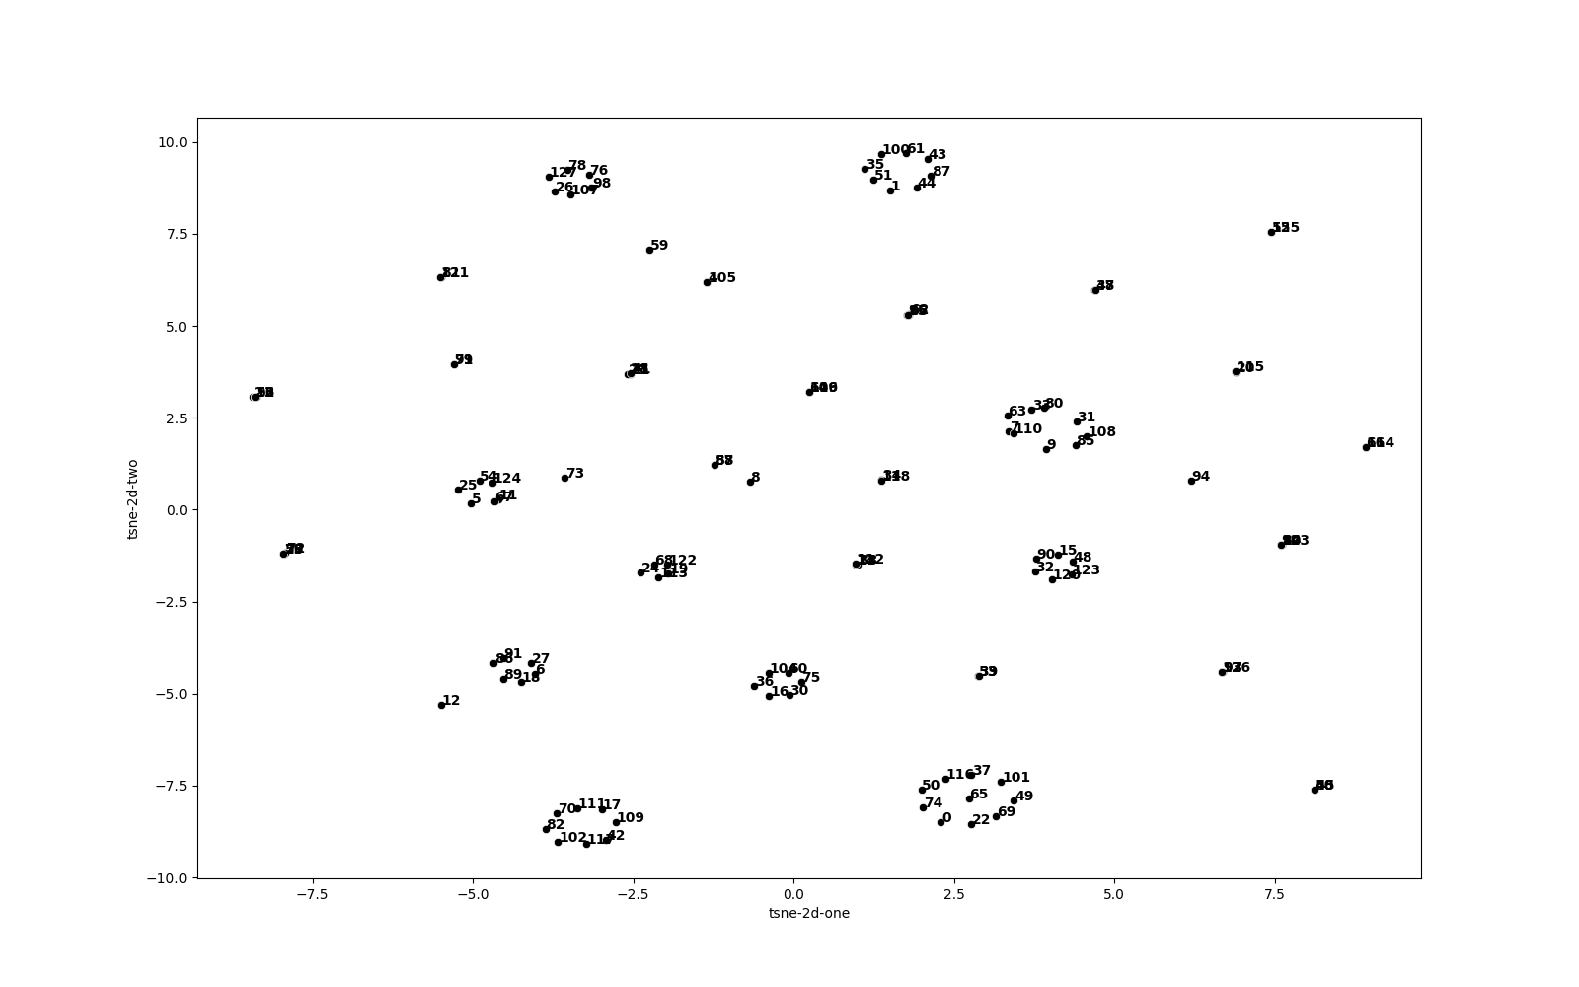
Methodologies (Continued..)
Issues for Codebook optimization
Codebook initialization.
Since the codebook is a learnable parameter the
initialization of the codebook can also impact
the convergence of the algorithm.
Different Initializations
Uniform Distribution
Normal Distribution
From the means of the latent vectors from each class of input data.
Uniform Distribution
Normal Distribution
Distribution of Means of Z_{e}’s

Slide 13
Experimental Results
Dataset: TorchSig
A Digital modulated signals library which has 53 different modulations that can be synthetically generated.
I chose to use only 6 of the modulations. They are:
4ask
8pam
16psk
32qam-cross
2fsk
Ofdm256
Dimension of the dataset 2 –channels (I and Q) since the we can’t use complex signals for neural networks we use complex2D transformation.
The dataset is already normalized since it’s a synthetic dataset.
The total number of samples of a signal for the experiments is 1024 IQ samples. Which gives the dimension of input signals as 2x1024.

Slide 14
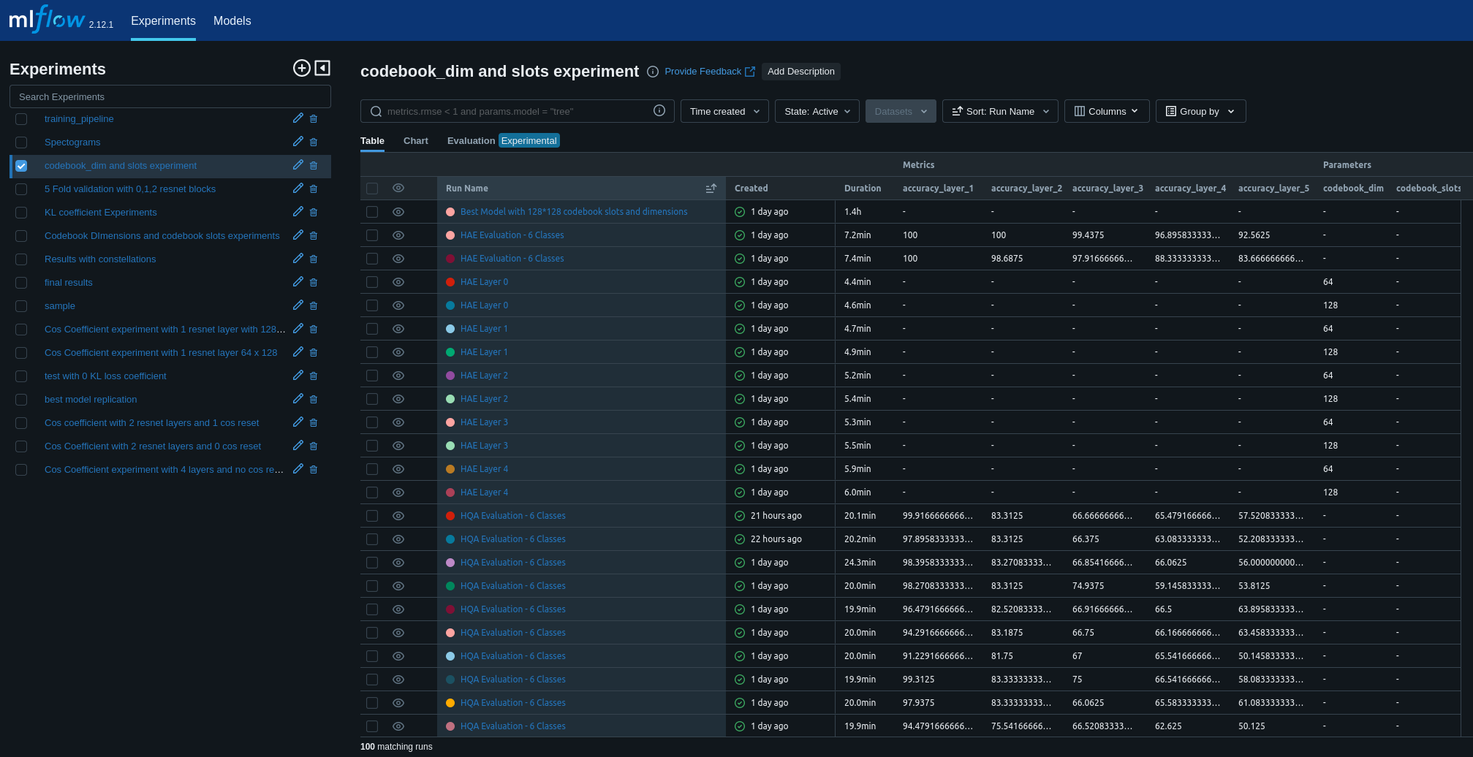
Experimental Results
The whole project code is written using MLOPs methodologies, to save all the articrafts like Constellation Diagrams, Spectrograms, confusion Matrices, etc.
Each Layer of HQA takes about an hour to train on only one Nvidia A6000 Gpu with IQ samples of 1024 per signal and 8000 samples per signal for about 10 epochs.

Slide 15
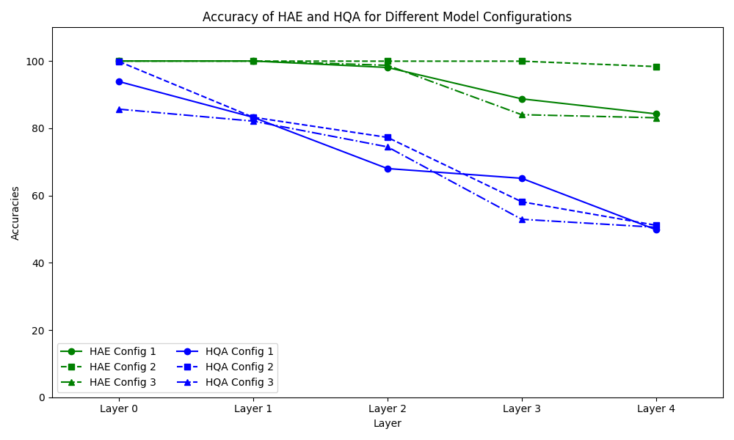
Experimental Results
Best HAE results.
Found the optimal set of Cos Coefficient for different layers.
Find the optimal set of Resnet blocks for each Encoder and Decoder Configuration.
Best Cos Loss coefficient for layers 0,1,2,3,4
[0.1,0.05,0.01,0.005,0.0001]
These are the average accuracies out of 5 different
runs with standard deviation of around 1-10% per config.
Config-1
0 Resnet blocks
Config-2
1 Resnet blocks
Config-3
2 Resnet blocks

Slide 16
Experimental Results
Compression with HQA.
The compression levels are calculated as in the formula yielded the following compression on different layers of model.
Layer | Input Dimensions (x or z_{e}) | Output Dimensions (z_{e}) | Compression Ratio (CR_{i})
L0 | 2 × 1024 | 64 × 512 | 1.37
L1 | 64 × 512 | 64 × 256 | 2.74
L2 | 64 × 256 | 64 × 128 | 5.48
L3 | 64 × 128 | 64 × 64 | 10.96
L4 | 64 × 64 | 64 × 32 | 21.92

Slide 17
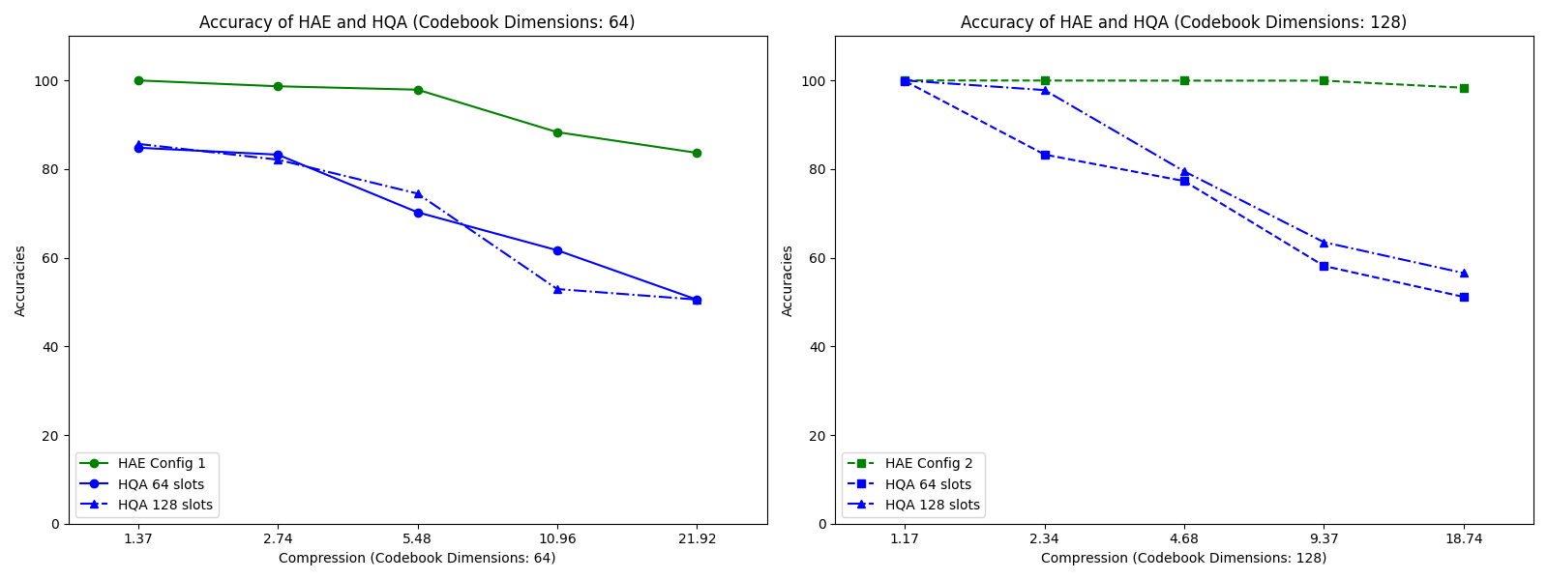
Experimental Results
Accuracy at different compression levels and codebook Dimension configurations.

Slide 18
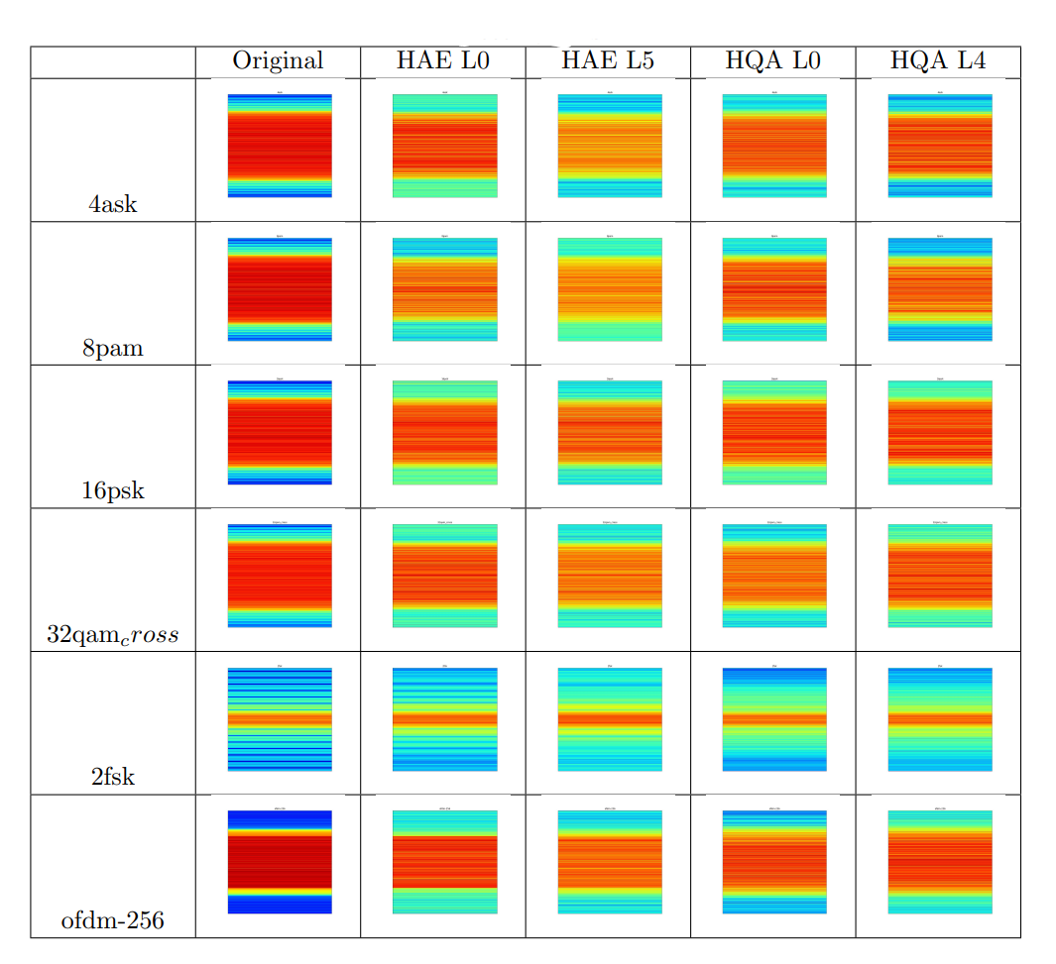
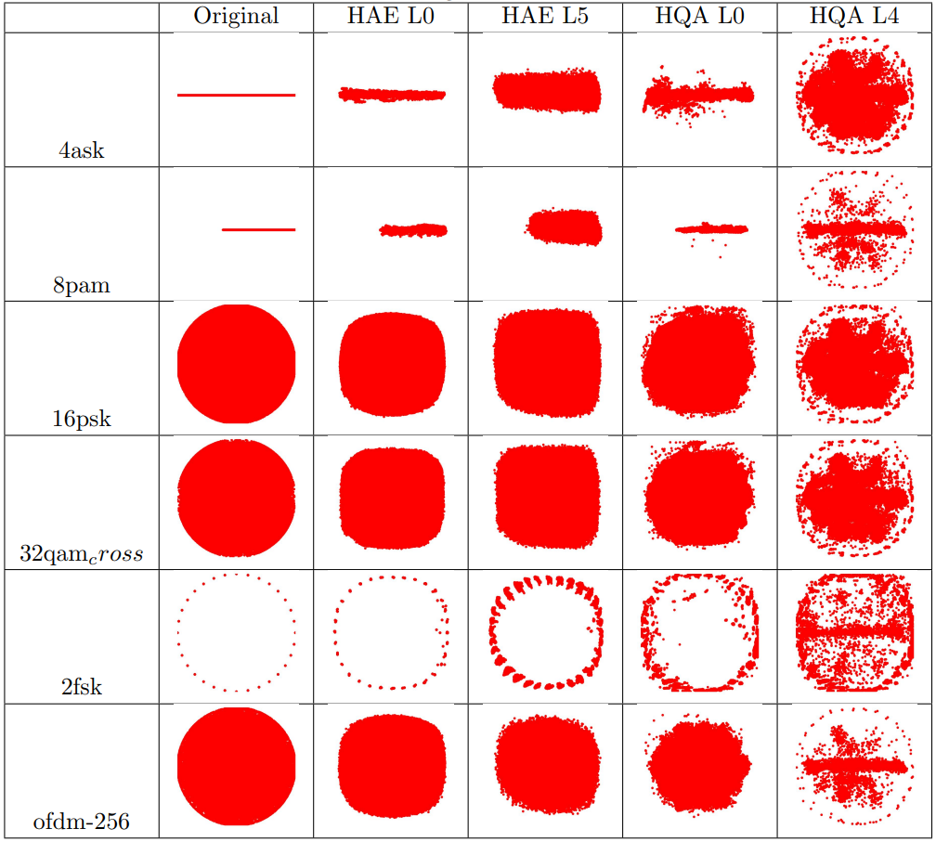
Experimental Results
Spectrograms
Constellations

Slide 19
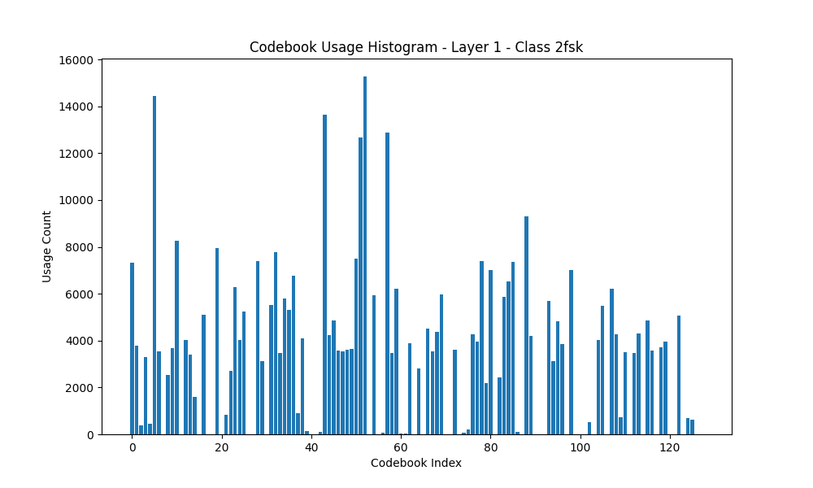
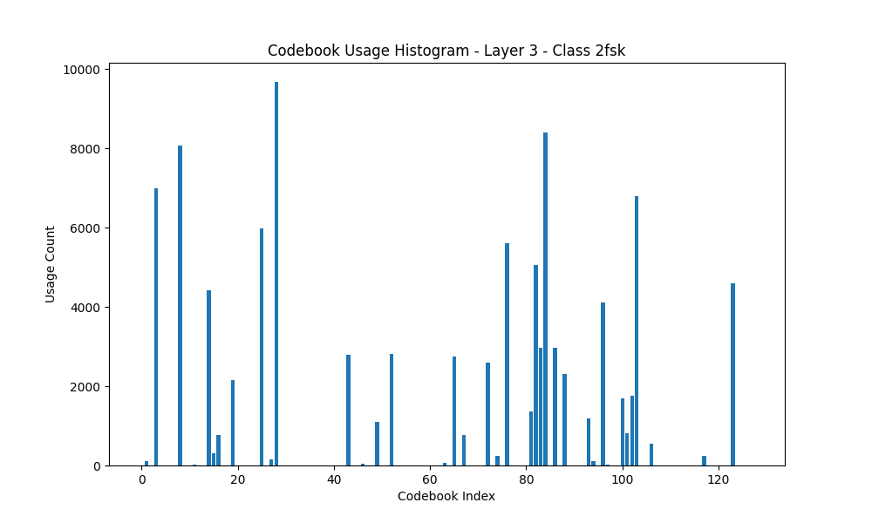
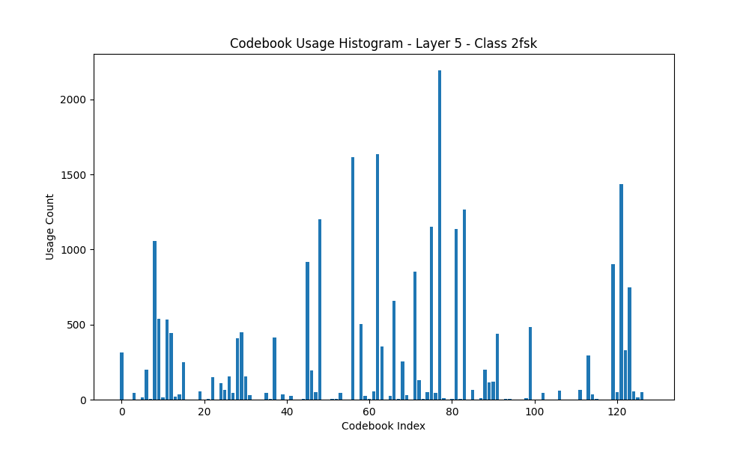
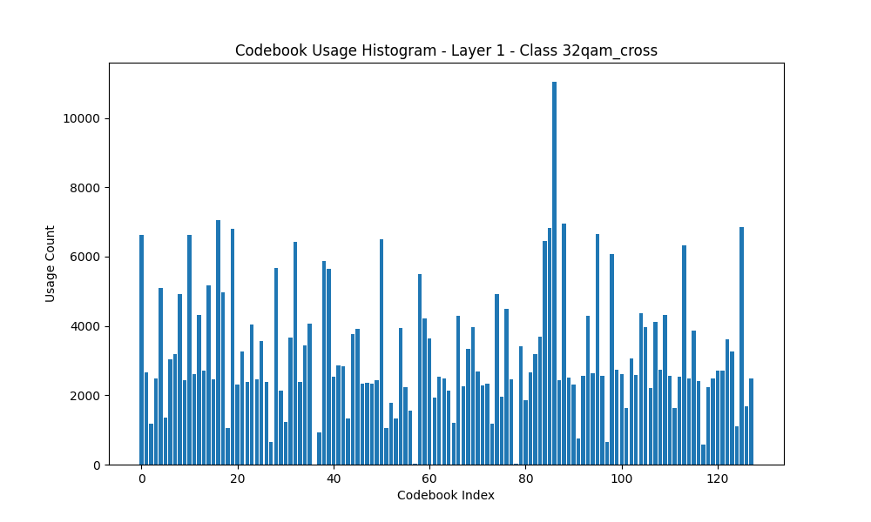
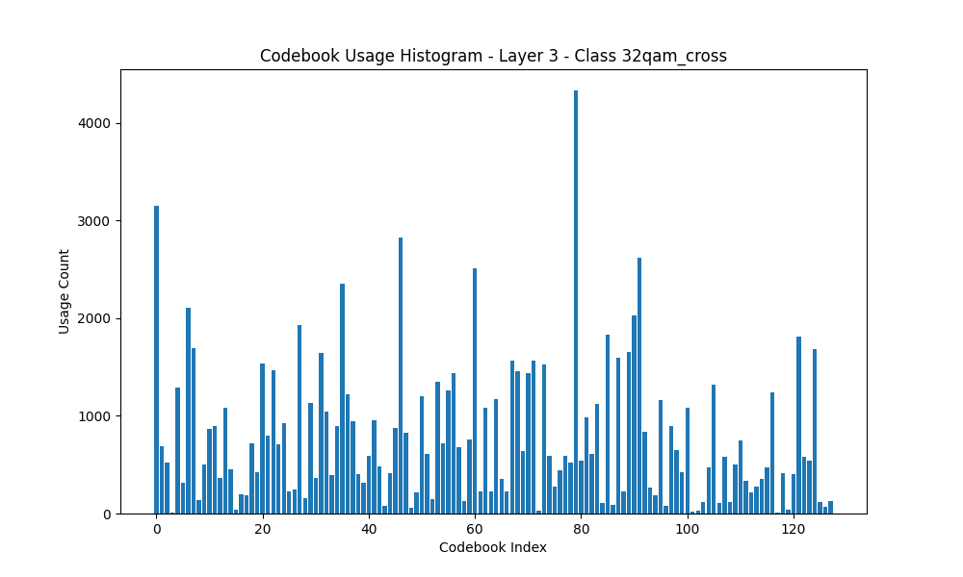
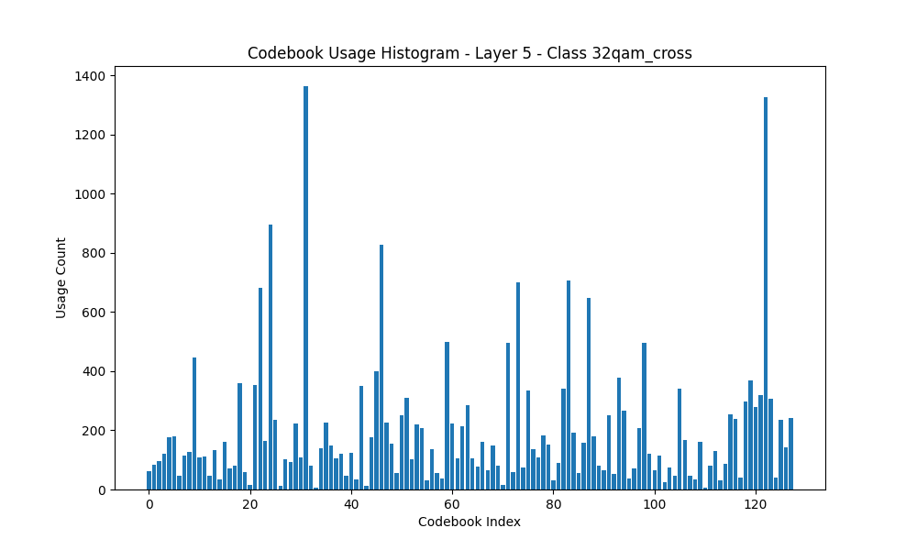
Codebook Usage of Histograms

Slide 20
Conclusions, Reflections, & Outlooks
Trade- off between compression ratio and classification accuracy.
Aim is to compress beyond certain threshold.
Generate New signals.
Future Work
De- Noising properties autoencoders.
Effect of different Loss coefficients on different layers

Slide 21
References
Van den Oord, A., Vinyals, O., & Kavukcuoglu, K. (2017). Neural Discrete Representation Learning. Advances in Neural Information Processing Systems, 30, 6306-6315.
Kondo, K., Tanaka, K., & Hirai, H. (2020). Hierarchical Generative Modeling for Audio Synthesis. arXiv preprint arXiv:2012.11861.
Razavi, A., Oord, A. V. D., & Vinyals, O. (2019). Vector Quantized Variational Autoencoders. arXiv preprint arXiv:1905.10548.
O'Shea, T., & Hoydis, J. (2017). Deep Learning for Wireless Communications. IEEE Transactions on Signal Processing, 65(11), 3551-3564.
Ye, J., Zhang, Z., & Xu, K. (2018). Deep Learning Based Signal Processing in Wireless Communications. IEEE Wireless Communications, 25(5), 59-65.
O'Shea, T., & Hoydis, J. (2017). End-to-End Deep Learning for Physical Layer Communications. IEEE Journal on Selected Areas in Communications, 35(10), 2403-2417.
Armani Rodriguez, Yagna Kaasaragadda, and Silvija Kokalj-Filipovic. Deep-learned compression for radio-frequency signal classification, 2024.

Slide 22
Questions?

